Slide 1
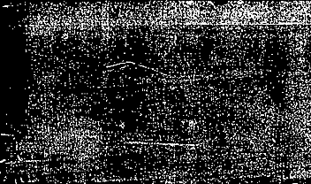
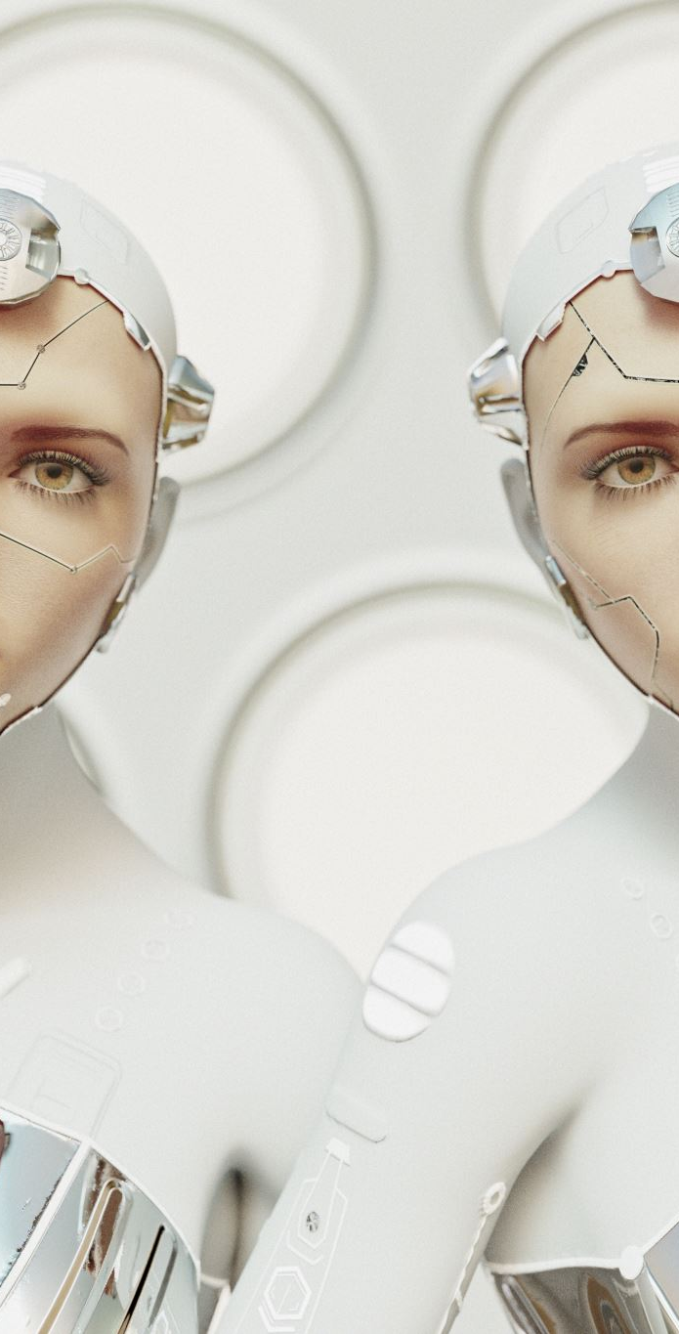

SKIN COLOR DETECTION USING CHROMATICITY
A Statistical Approach to Skin Detection using Chromaticity
Group Members:
KIC-HNDCSAI-252F-031
KIC-HNDCSAI-252F-032
KIC-HNDCSAI-252F-039
KIC-HNDCSAI-252F-043

Slide 2
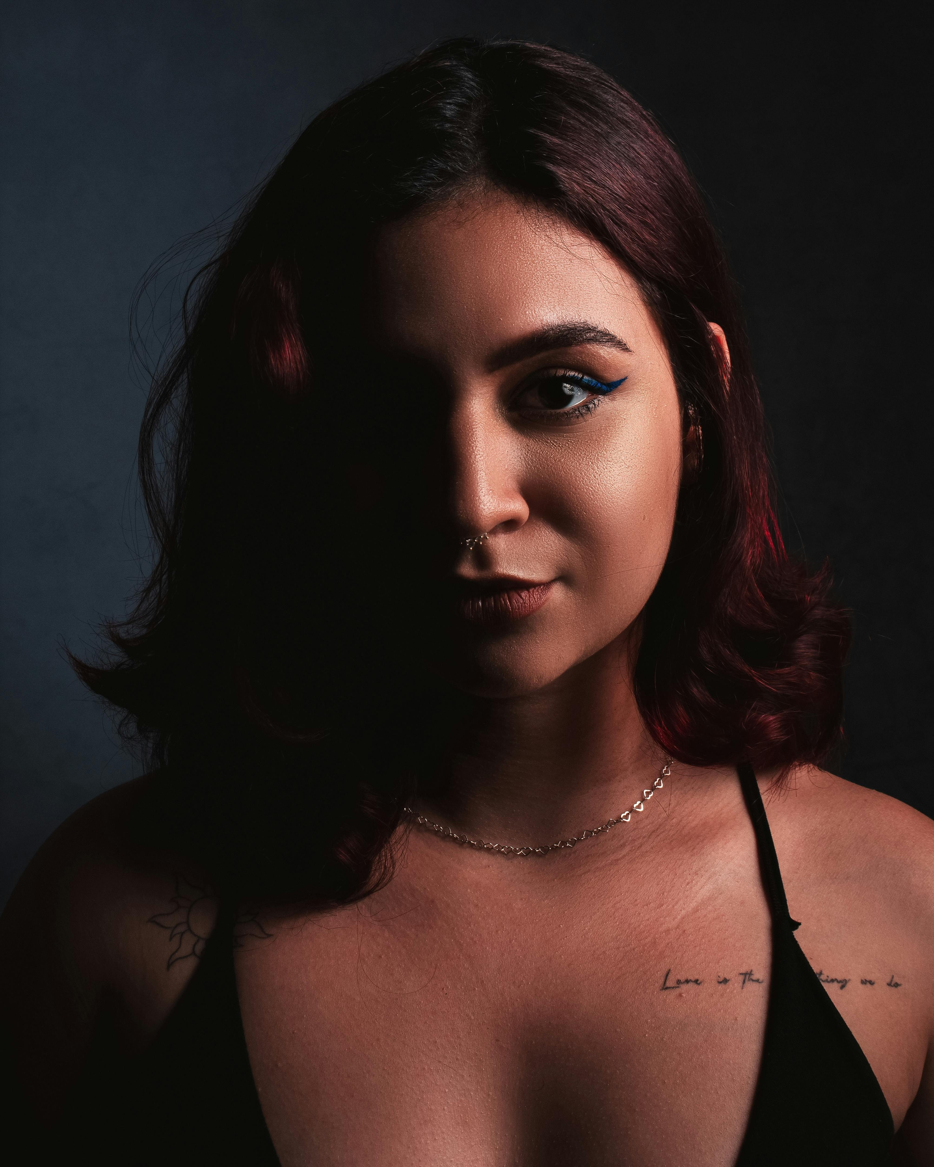
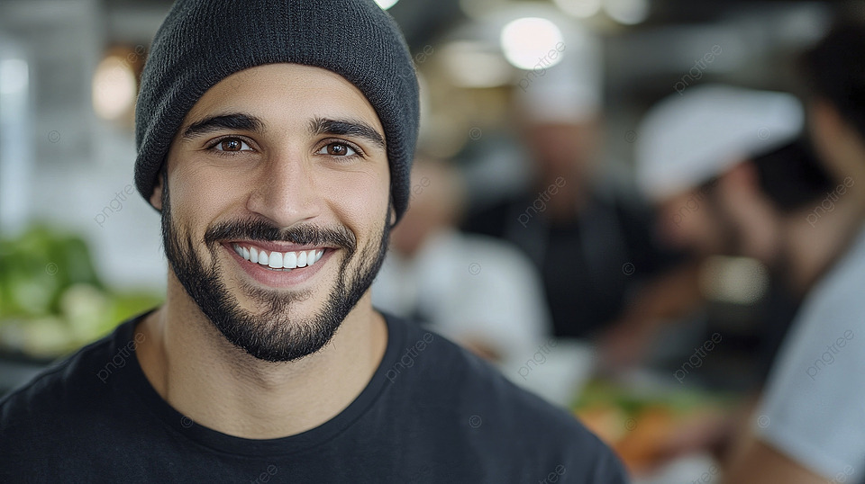
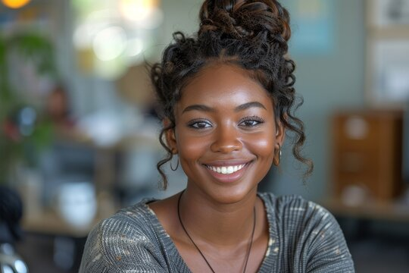
Introduction
• Skin detection is a key task in computer vision
• Used in:
- Face detection
- Human tracking
- Gesture recognition
• Challenging due to:
- Different skin tones
- Lighting variations
• This project detects skin using color analysis

Slide 3
Objective
• Detect skin regions in images
• Use chromaticity color space
• Build a statistical skin model
• Classify pixels as:
- Skin
- Non-skin
• Visualize results clearly

Slide 4
Dataset
• Dataset stored in folders:
- Images
- Cropped skin regions
• Contains:
- Different skin tones
- Various lighting conditions
- Multiple backgrounds
• Cropped images used for training

Slide 5
Sample Images & Cropped Regions
• Original images loaded from dataset
• Corresponding cropped skin regions displayed
• Cropped regions contain only skin pixels
• Used as ground truth for training

Slide 6
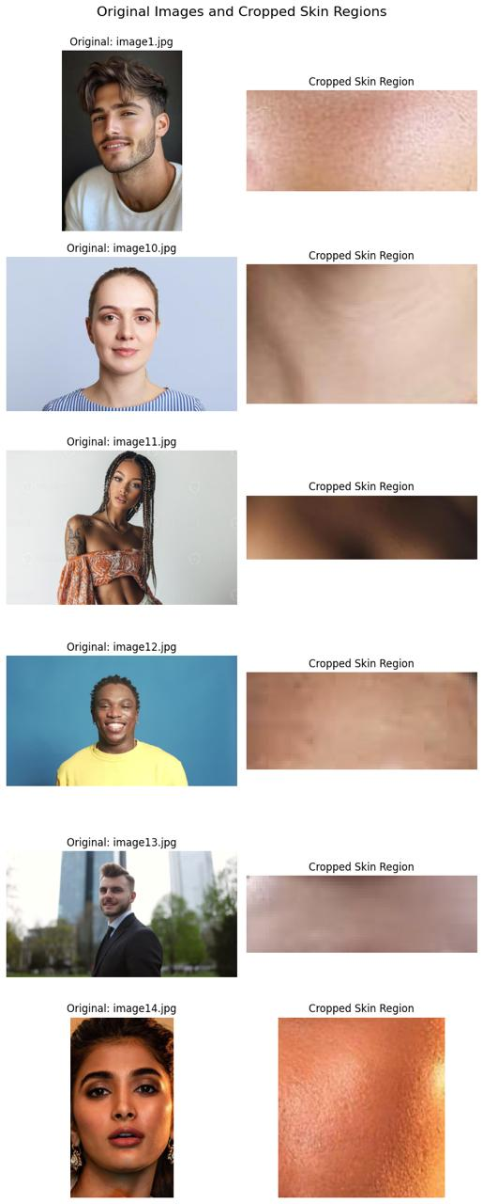

Slide 7
Image Loading
• Images loaded using OpenCV
• Converted from BGR → RGB
• Displayed using matplotlib
• Multiple samples visualized

Slide 8
Skin Region Selection
• Skin regions manually cropped
• Extracted only skin pixels
• Ensures accurate training data
• Used to build statistical model

Slide 9
Chromaticity Concept
• Convert RGB → chromaticity
x = R / (R + G + B)
y = G / (R + G + B)
• Removes brightness effects
• Focuses only on color
• Reduces lighting impact

Slide 10
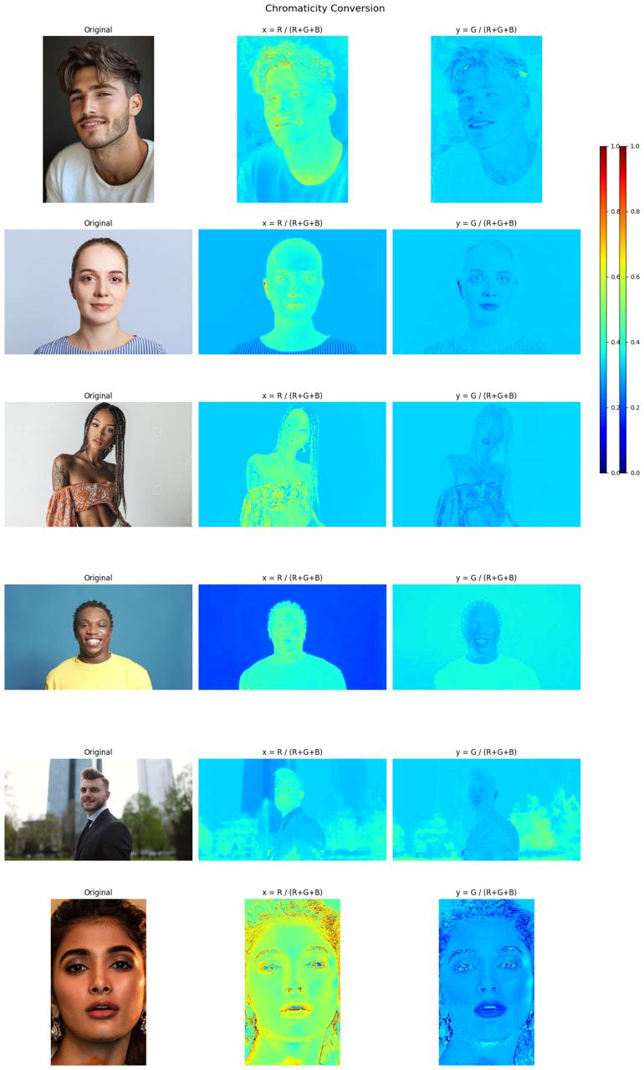
Chromaticity Conversion Results
• Images converted into x and y channels
• Shows normalized color representation
• Skin regions appear consistent
• Helps separate skin from background

Slide 11
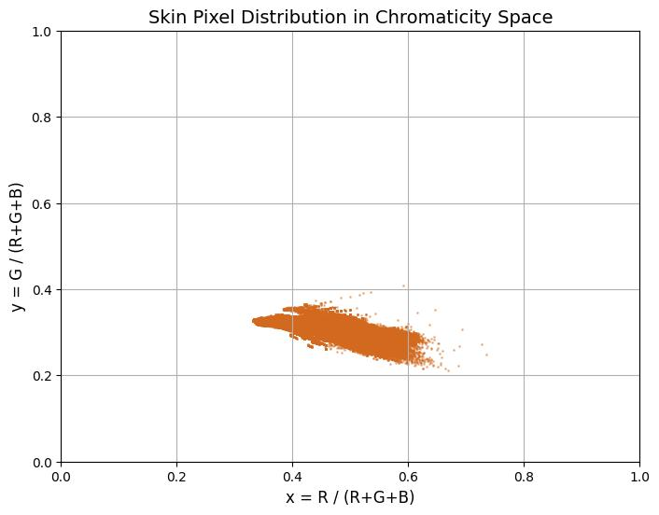
Skin Pixel Distribution
Skin pixels plotted in chromaticity space (x, y)
Each point = one skin pixel
x-axis → Red proportion (R / (R+G+B))
Indicates similarity in skin color
Shows that skin colors are similar in normalized space
Distribution is not random → follows a pattern
Distribution is not random → follows a pattern

Slide 12
Gaussian Probability Function
• Probability calculated using Gaussian formula
• Measures likelihood of a pixel being skin
• Uses:
- Mean vector
- Covariance matrix
- Inverse covariance
- Determinant
• Higher probability → more likely skin
• Convert image to chromaticity
• Compute probability for each pixel
Apply threshold rule:
IF probability > threshold → Skin
ELSE → Non-skin
• Generates binary mask

Slide 13
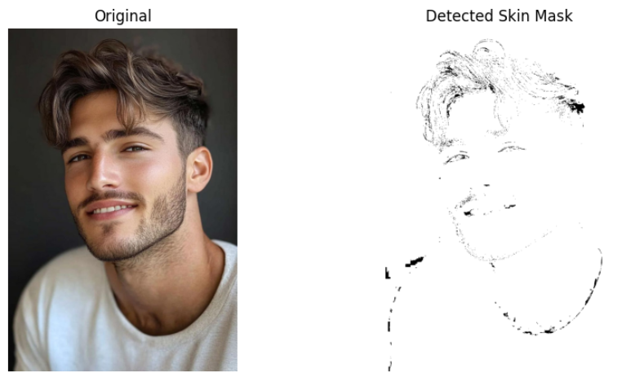
Problems with Gaussian Method
Probability values are very small
Difficult to choose correct threshold
Small change in threshold → big change in result
Sensitive to noise and lighting
Computationally expensive (slow loops)
Not intuitive (hard to interpret probability)

Slide 14
Mahalanobis Distance Method
Distance-based classification method
Measures how far a pixel is from skin distribution
Uses:
Mean vector
Covariance matrix
Takes into account data spread and shape
Smaller distance → more likely skin
Larger distance → non-skin
Convert image to chromaticity (x, y)
For each pixel:
Compute Mahalanobis distance
Apply threshold:
If distance < threshold → Skin
Else → Non-skin
Output → Binary mask

Slide 15
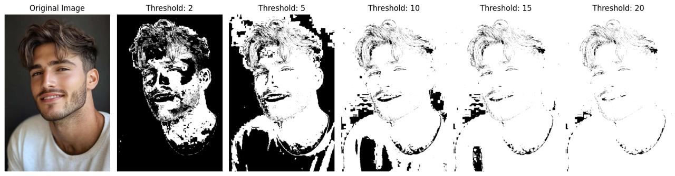
Threshold Selection
• Tested multiple thresholds:
- 2, 5, 10, 15, 20
• Controls detection sensitivity
• Lower threshold → more detection (noise)
• Higher threshold → less detection
• Best threshold selected = 5

Slide 16
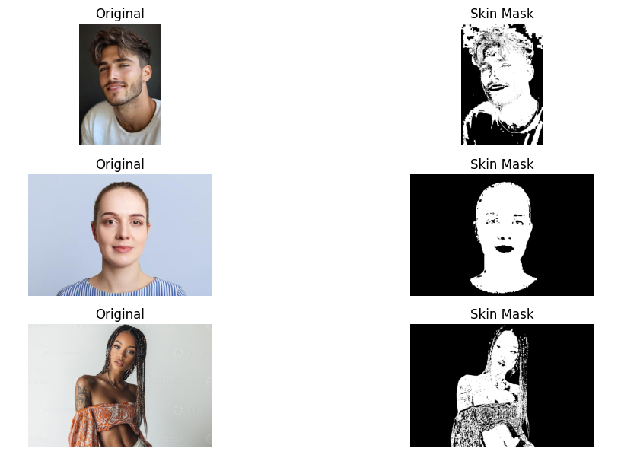
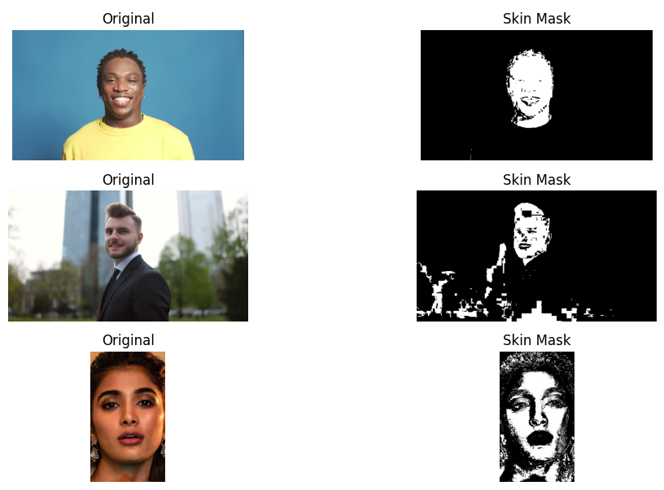
Our results

Slide 17
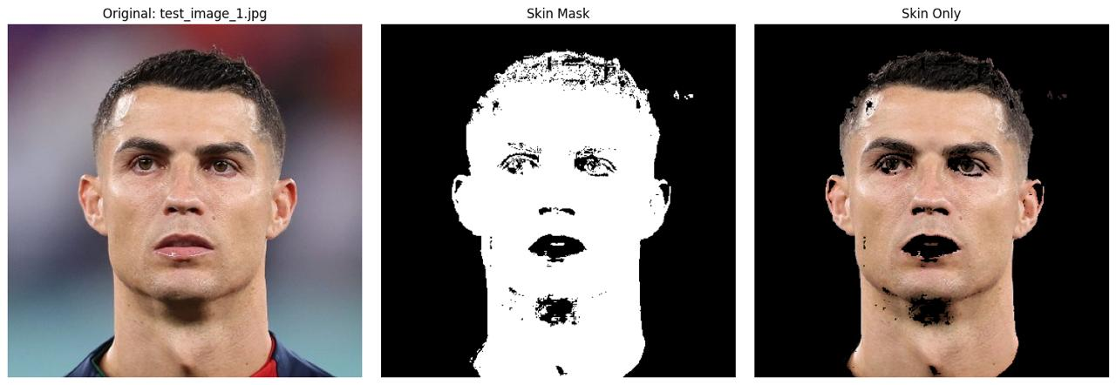
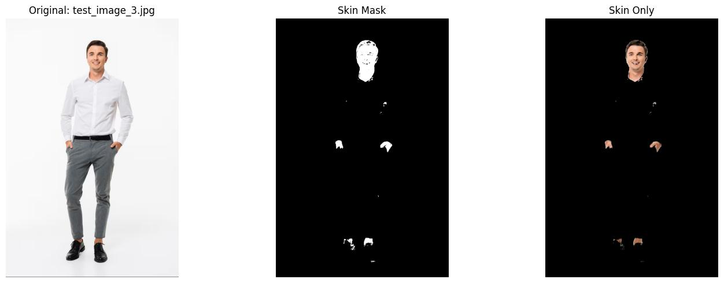
Skin Detection Results
• Output includes:
- Binary mask
- Skin-only image
• Skin regions successfully detected
• Works across multiple images

Slide 18
Analysis
Advantages:
• Robust to lighting changes
• Chromaticity removes brightness effects
• Gaussian model is effective
Limitations:
• Confuses similar colors (hair, clothes)
• Sensitive to threshold
• Some noise remains

Slide 19
Conclusion
• Skin detection implemented successfully
• Used chromaticity + Gaussian model
• Mean and covariance used for modeling
• Threshold-based classification applied
• Method is effective but not perfect
• Can be improved using advanced models

Slide 20
THANK YOU

